Slide 1
Food Order Website

Slide 2
Hello!
I am nevil
I am here because I love the webdevlopment
You can find me at email
Nevilmistry26@gmail.com

Slide 3
Introduction
This project is aimed at developing a Web application that depicts Food order and purchasing the Food Online.
Using this software, Hotels can improve the efficiency of their services to providing their food to the customer. This web application involves all the features of the latest Food order websites .

Slide 4
Introduction
This web application involves all the features of the latest Food order websites
This website divided into two modules
1.Client side
2.Admin side

Slide 5
Technology used
1
Let’s start with the technology

Slide 6
Technology used
Frontend
React JS (Frontend library)
Css (Style the webpages)
Backend
Express (Backend Framework)
Node JS

Slide 7
Technology used
Database
Mongo db
Other Tools
Mongoose
Redux
Morgan
Concurrently

Slide 8
Objective
2
Let’s start with the objective

Slide 9
Objective
Objective is to provide the website to the hotel which unable to easy to order food from online for the users or customers.
This website is reduce the manual operation and maintain all records of order information on the database.
Main concept of this website is to maintain the orders reports and to maintain customer records and also generates the various reports for analysis for the admin.

Slide 10
System flow chart
3
Let’s start with the systemflowchart

Slide 11
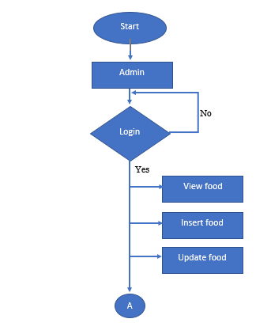
Admin flow chart

Slide 12
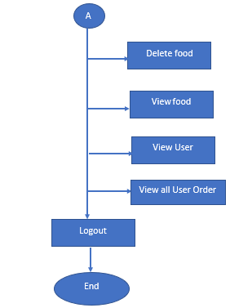
Admin flow chart

Slide 13
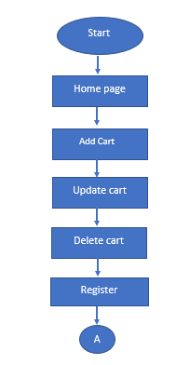
Client flow chart

Slide 14
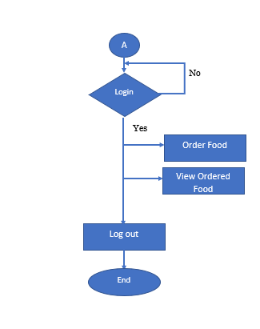
Client flow chart

Slide 15
Dfd /Uml diagram
4
Let’s start with the Dfd and Uml diagram

Slide 16
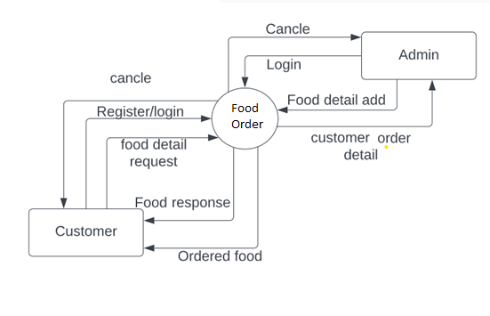
0 Level for food order

Slide 17
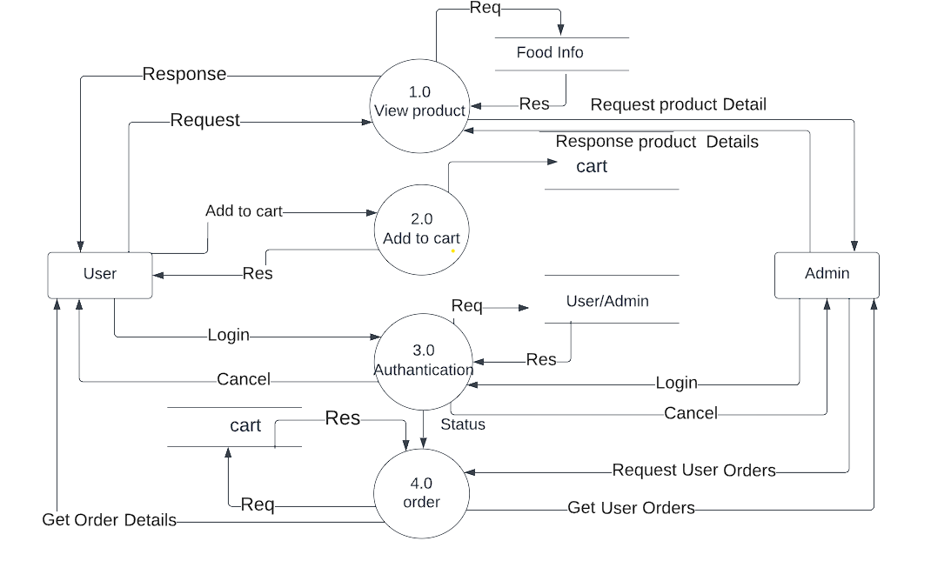
1st level dfd for admin & client

Slide 18
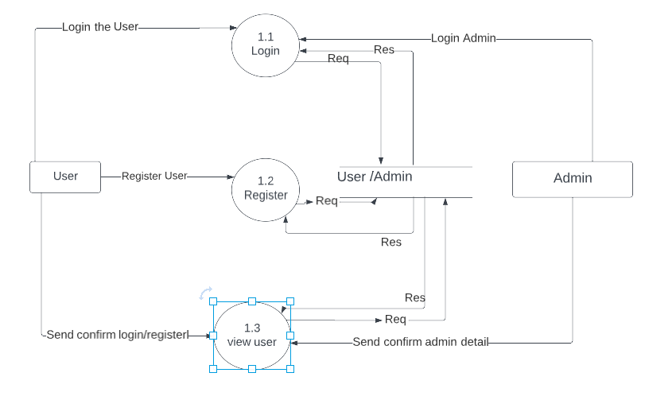
2nd level dfd User & Admin
1.0 registration & login for admin & User

Slide 19
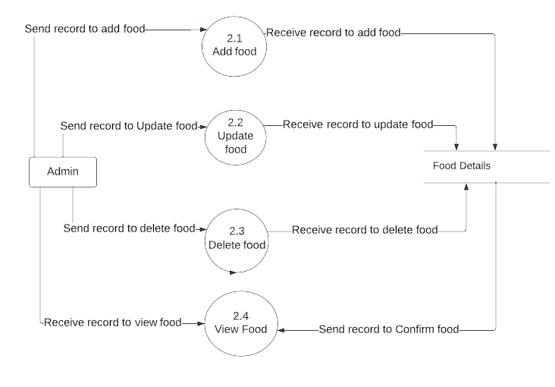
2.0 View food from admin Side

Slide 20
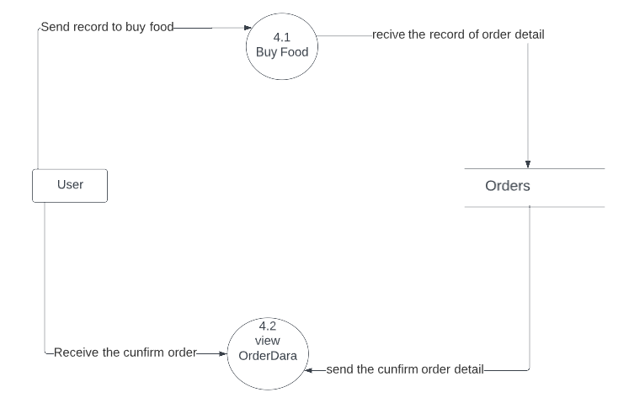
3.0 Order process from client side

Slide 21
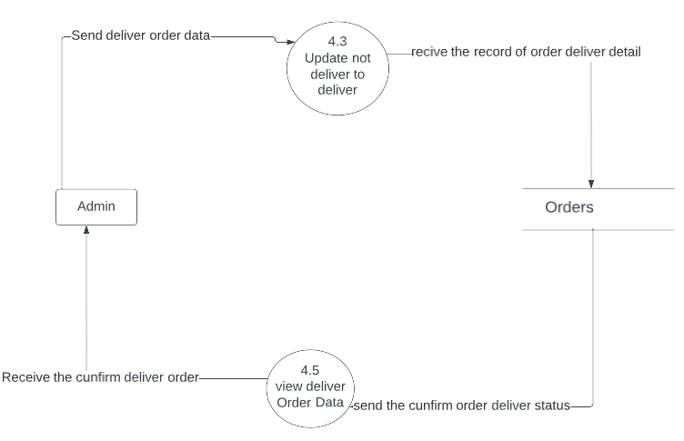
4.0 Order process from Admin side

Slide 22
Structure of Database
5
Let’s start with the structure of database

Slide 23
Structure of User collection
1.User
{ _id : int32,
name : string,
email : string,
pass : string
isAdmin : boolean
}

Slide 24
Structure of Food collection
2.Food
{ _id : int32,
name : string,
varientes: array,
prices :array,
catagary : String,
image : String
}

Slide 25
Structure of orders collection
3.Orders
{ _id : int32,
name : string,
email : string,
usid : string
orderItem : array

Slide 26
Continue…..
shippingAddress : {
address : string,
pin : string,
city : string
},
orderAmount : string,
isDelivered : Boolean
}

Slide 27
Screenshot
6
Let’s start with the Screenshot

Slide 28
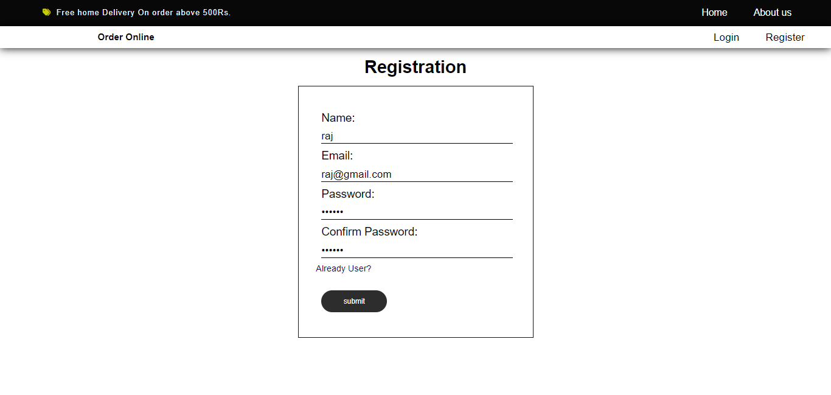
1.Registration page

Slide 29
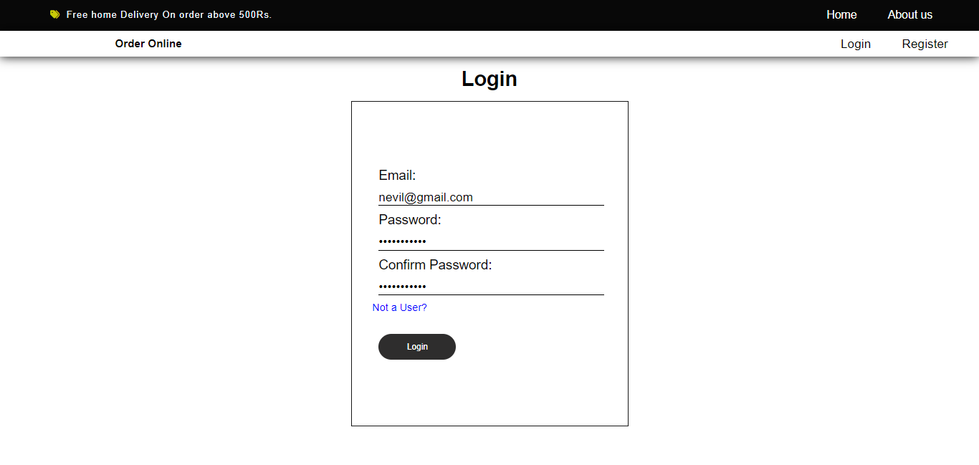
2.Login page

Slide 30
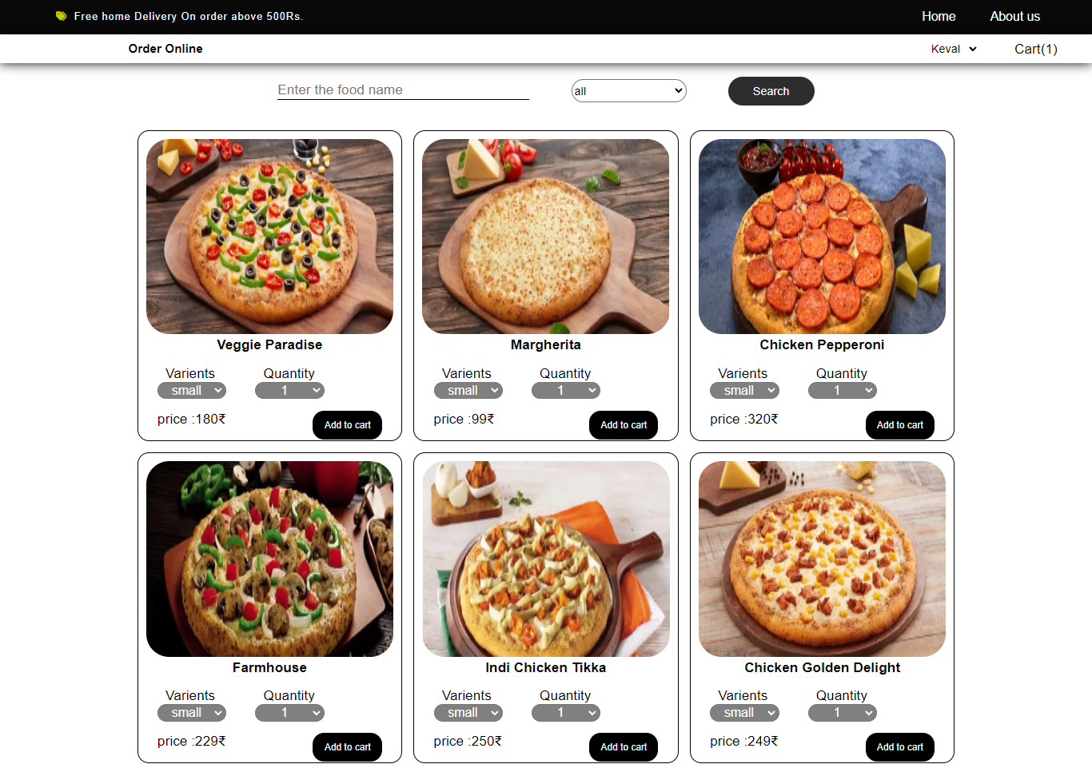
Client/User
3.Home page

Slide 31
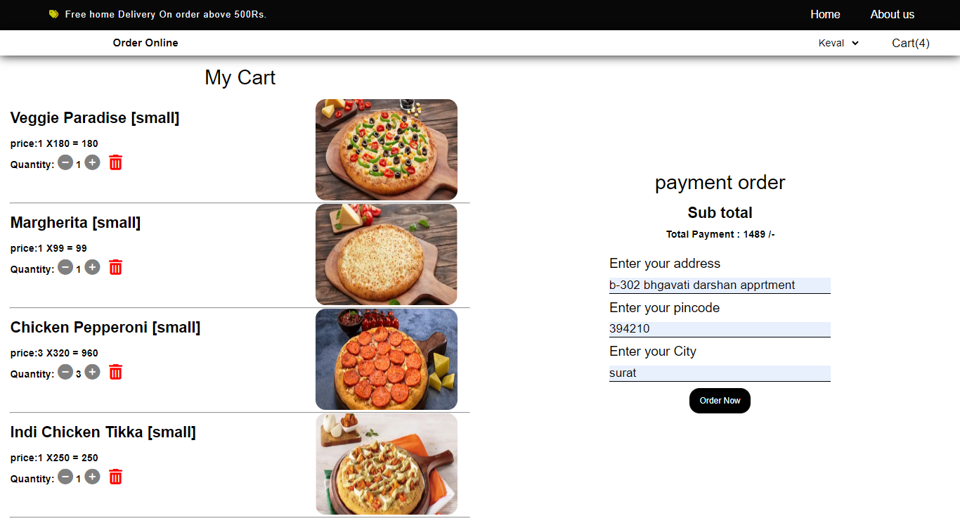
4. Add to cart page

Slide 32
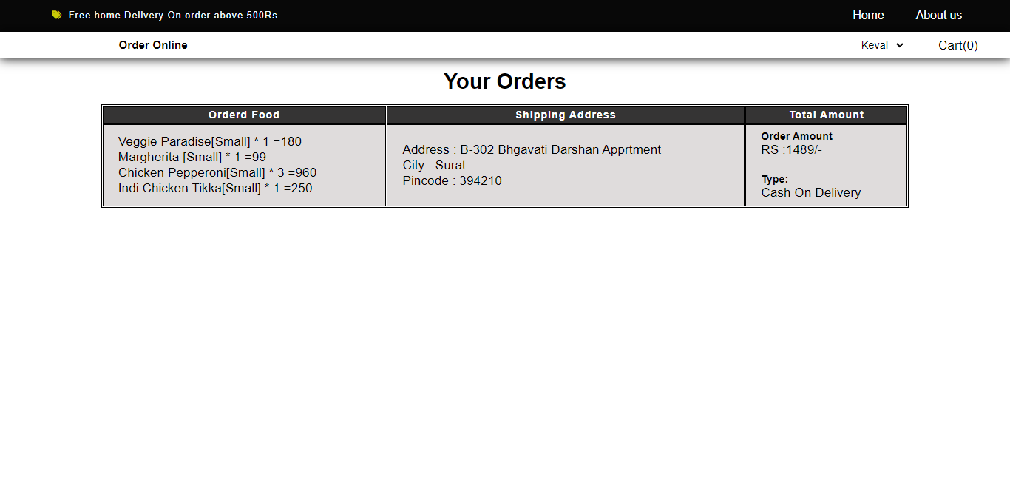
5.Order Details

Slide 33
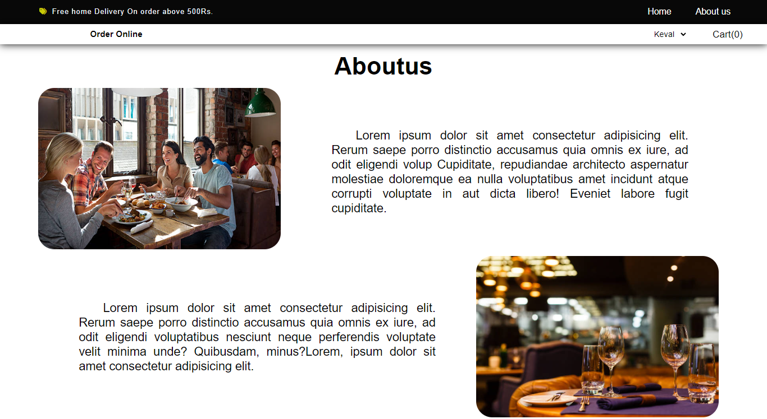
6. About us page

Slide 34
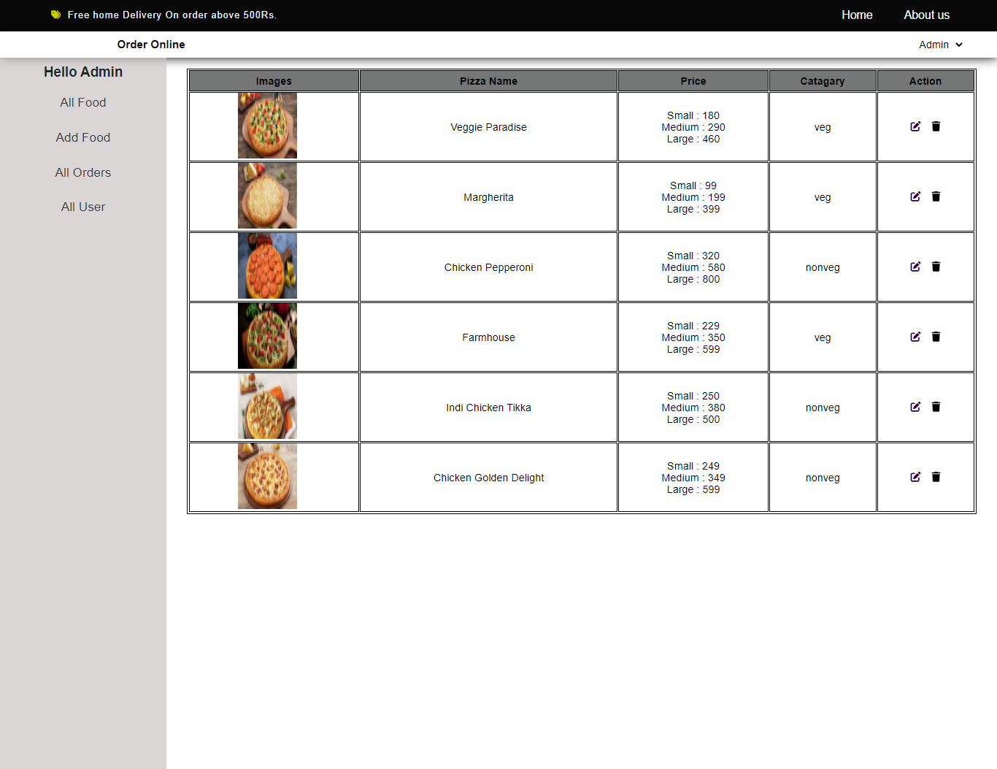
Admin
7. All foods

Slide 35
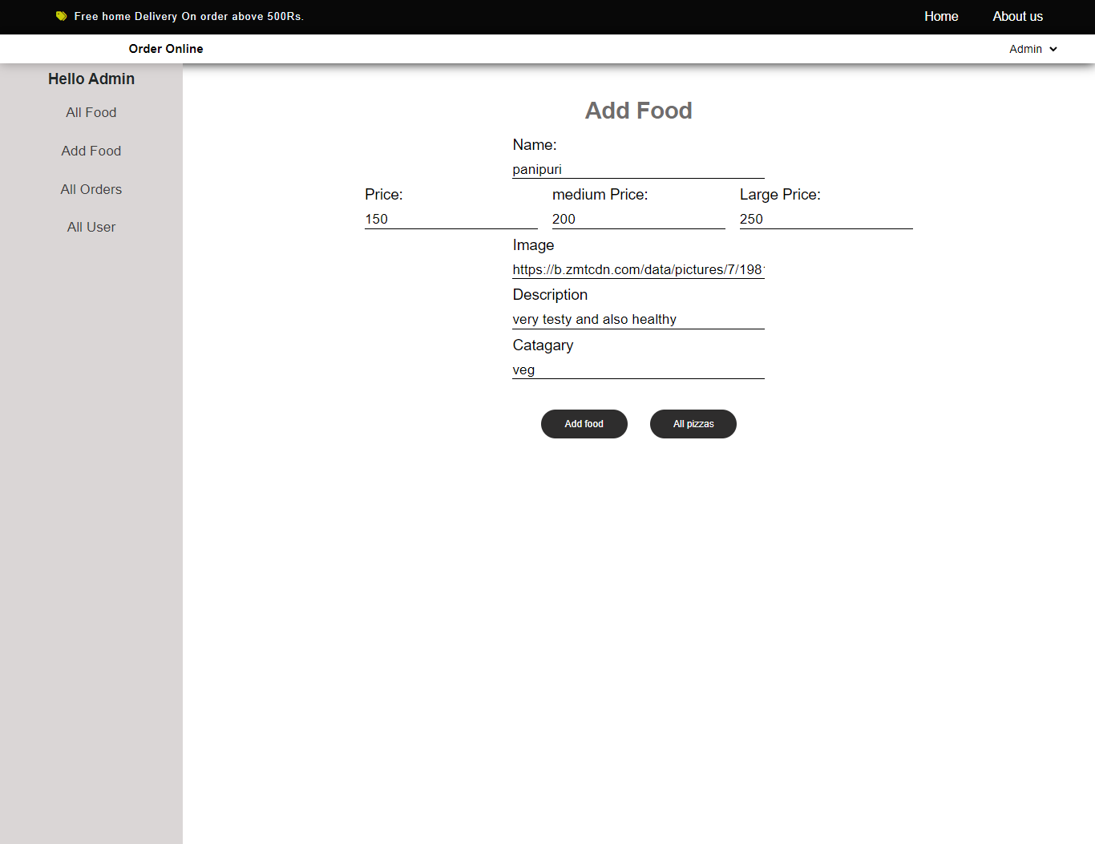
8. Add food

Slide 36
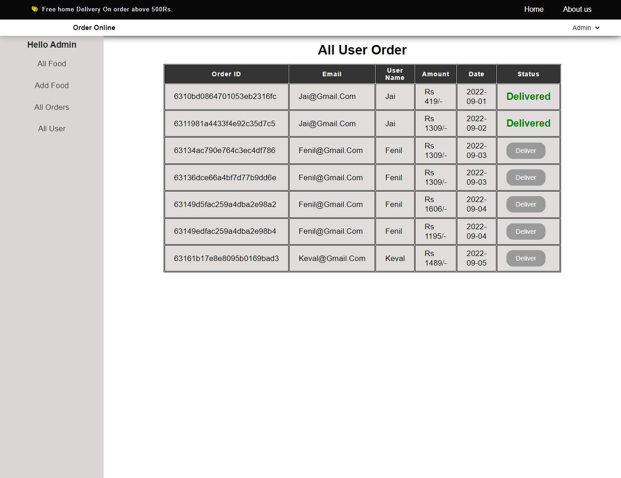
9 . All User Order Status

Slide 37
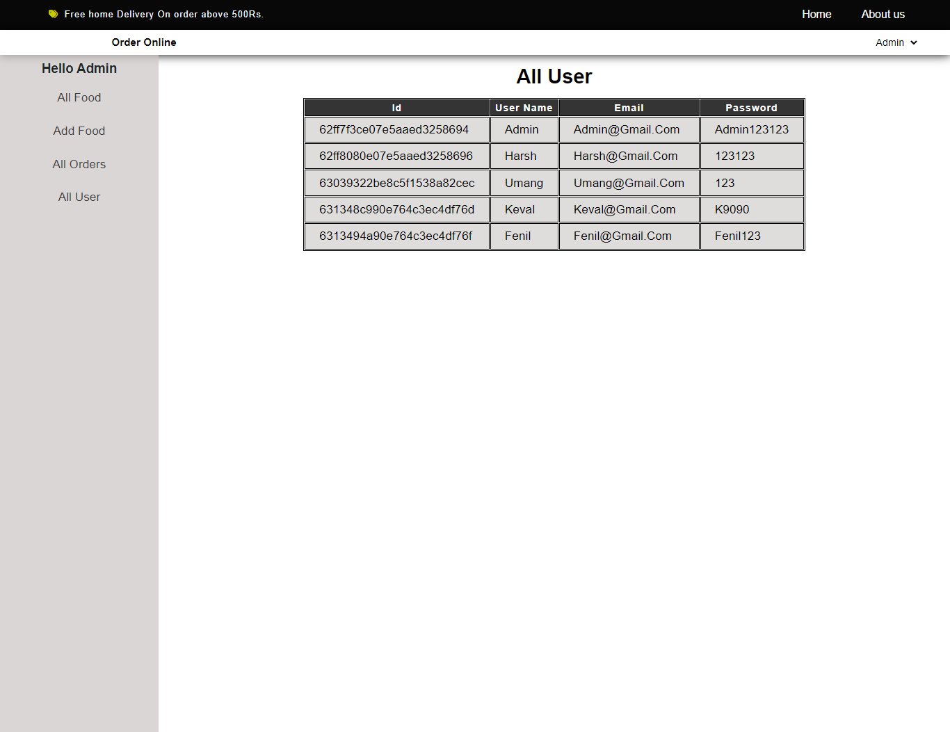
10. All User

Slide 38
References
7
Let’s start with the objective

Slide 39
References
React.org (for react)
https://nodejs.org/en/docs/ (for node js)
3. https://mongoosejs.com/docs/models.html (For creating schema and connection with database and perform the opration with database)
4. https://expressjs.com/en/4x/api.html#express.router (For api request in express)
5. techinfoyt youtube channel (For Database connection)
6. https://react-redux.js.org/tutorials/quick-start (for redux state mangement tools)

Slide 40
THANKS!
Any questions?
You can find me at nevilmistry26@gmail.com

